Slide 1
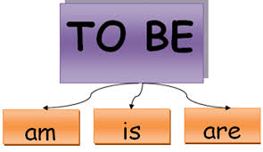
Verb
Forms of “to be”

Slide 2
Instructions:
Look at the pictureS and sAY a sentence using the verb be.

Slide 3


Slide 4
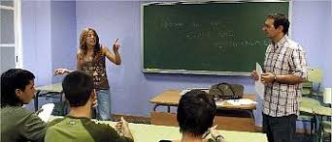

Slide 5


Slide 6


Slide 7


Slide 8


Slide 9


Slide 10


Slide 11


Slide 12


Slide 13
Thanks

